Slide 1

calculator
Using HTML,CSS,JS
PRIYANSHU SHAHI(leader)
GAURAV SUNAL
CHANDAN SINGH

Slide 2

ABOUT CALCULATOR
A calculator is a device that performs arithmetic operations on numbers. Basic
calculators can do only addition, subtraction, multiplication and division
mathematical calculations.

Slide 3

OBJECTIVES
The objectives of CALCULATOR for Real-Time Applications are given below:
To enhance the calculations for CALCULATOR System done in Real Time.
Presently, work on basic calculation our motto is to achieve higher calculations / scientific calculation in real time.

Slide 4

PROBLEM STATEMENT
The Problem statement of CALCULATOR for Real-Time Applications are given below:
To do calculation in real time.
Enhance the Speed.
Do large calculation in few time.

Slide 5
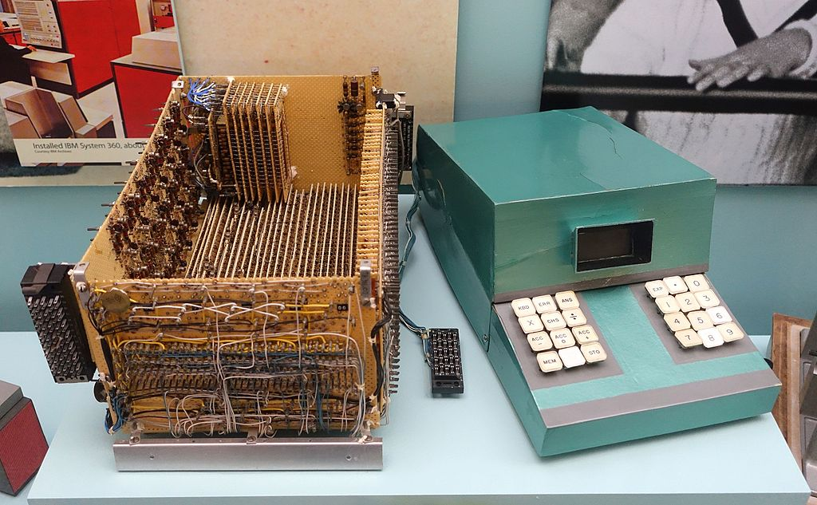
HISTORY
An electronic calculator is typically a portable electronic device used to perform calculations, ranging from basic arithmetic to complex mathematics. Modern electronic calculators vary from cheap, give-away, credit-card-sized models to sturdy desktop models with built-in printers. They became popular in the mid-1970s as the incorporation of integrated circuits reduced their size and cost. By the end of that decade, prices had dropped to the point where a basic calculator was affordable to most and they became common in schools.
In addition to general purpose calculators, there are those designed for specific markets. For example, there are scientific calculators which include trigonometric and statistical calculations. Some calculators even have the ability to do computer algebra. Graphing calculators can be used to graph functions defined on the real line, or higher-dimensional Euclidean space. As of 2016, basic calculators cost little, but scientific and graphing models tend to cost more. With the very wide availability of smartphones, tablet computers and personal computers, dedicated hardware calculators, while still widely used, are less common than they once were. In 1986, calculators still represented an estimated 41% of the world's general-purpose hardware capacity to compute information. By 2007, this had diminished to less than 0.05%

Slide 6
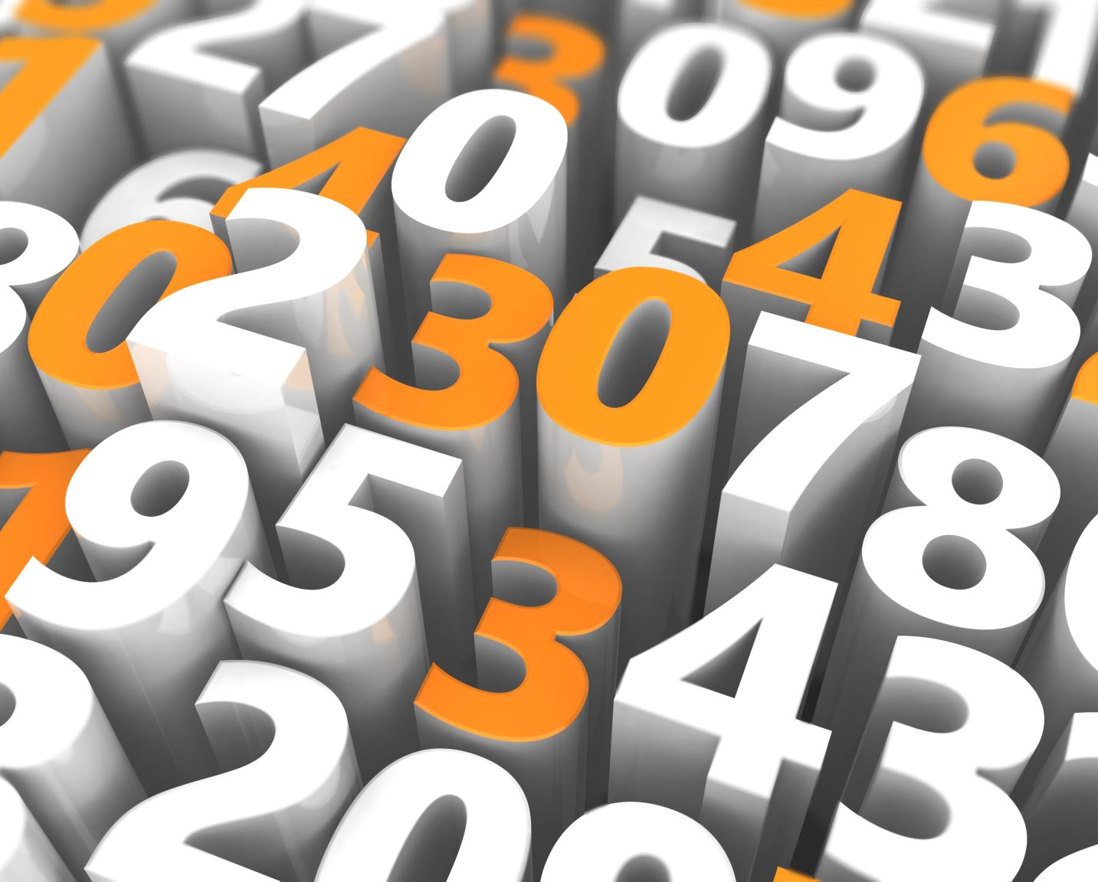
FEATURES OF THE CALCULATOR
In this project, you are going to develop a calculator that will have the following features:
It will perform basic arithmetic operations like addition, subtraction, division, and multiplication.
It will perform decimal operations.
The calculator will display Infinity if you try to divide any number by zero.
It will not display any result in case of invalid expression. For example, 5++9 will not display anything.
Clear screen feature to clear the display screen anytime you want.

Slide 7
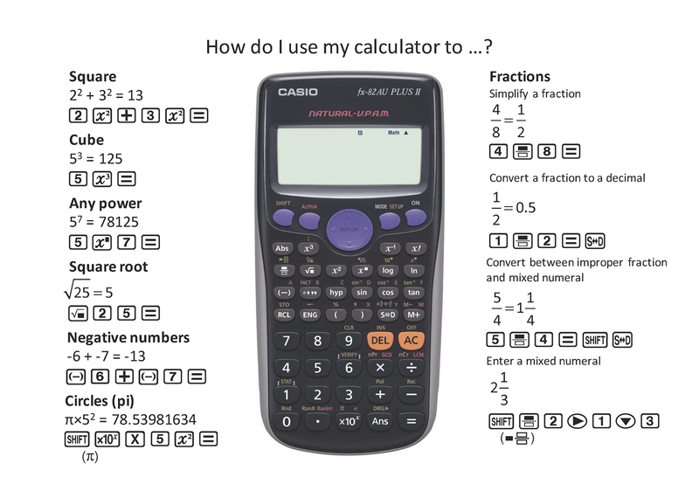
COMPONENTS OF THE CALCULATOR
The calculator consists of the following components:
Mathematical Operators: Addition (+), Subtraction (-), Multiplication (*), and Division (/).
Digits and Decimal Button: 0, 1, 2, 3, 4, 5, 6, 7, 8, 9, . .
Display Screen: It displays the mathematical expression and the result.
Clear Screen Button: It clears all mathematical values.
Calculate button (=): It evaluates the mathematical expression and returns the result

Slide 8
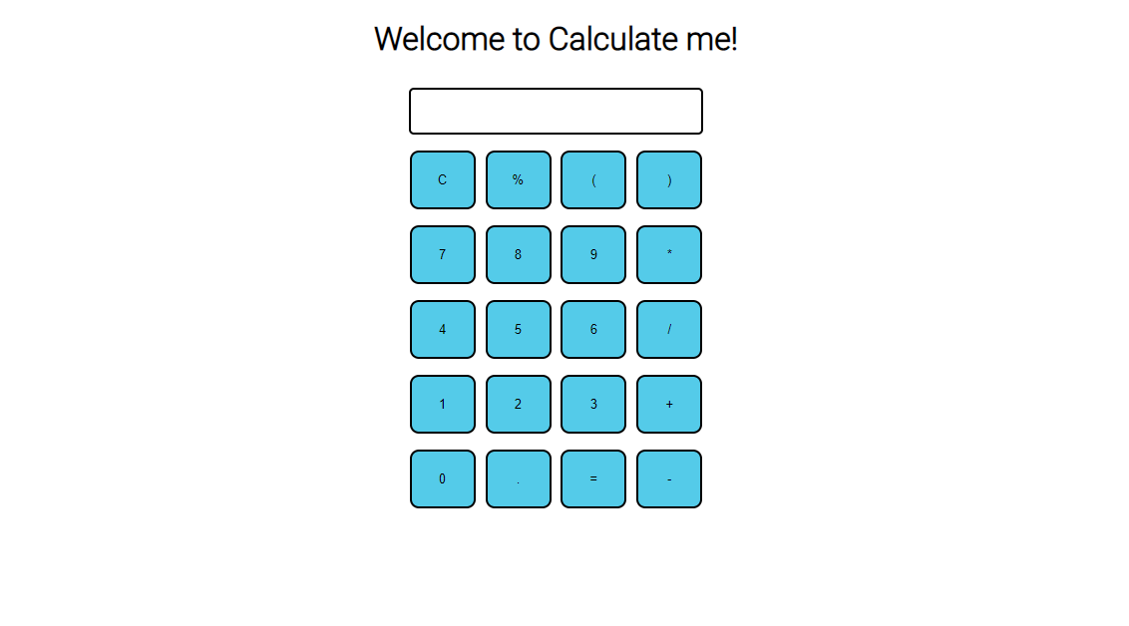
UI-INTERFACE

Slide 9
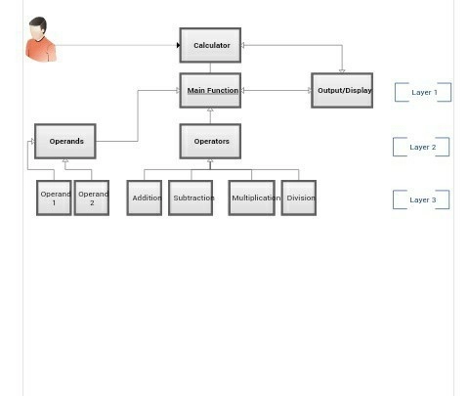
ER-DIAGRAM

Slide 10
LIMITATIONS
It is not designed for complex equations.
It Contains less keys(buttons).
It is not Able to calculate Pi, exponents, logarithms, trigonometric symbols (sin, cos, tan), and plot data.
Does not come with graphing feature.
Great for middle school not for college math classes, science labs, etc.

Slide 11
CODE:
PROJECT LINK:
https://basic-calculate-me.netlify.app

Slide 12
THANK YOU

